Slide 1
EMS Interoperability Task Force August 10, 2023
EMS-to-Hospital Information Flow
Notes:
This meeting is being recorded and will be posted. If you need anything removed from the recording, let us know.
Note change to moderated format, use hand raise feature to be acknowledged to speak.

Slide 2
Task Force Overview
Monthly, 2nd Thursday, 11a–12:30p MT
Aug 10, Sep 14, Oct 12, Nov 9, Dec 14
Topics:
Feb 16: Identifying data exchange partners and establishing relationships
Mar 9: Governmental, regulatory, and contractual environment
Apr 13: Regulatory environment and national networks recap
May 11: Sequence/workflow: SAFR design
June 8: Sequence/workflow
July 13: Standards and profiles overview
Specific standards and profiles to use in workflow:
August 10: EMS to Hospital
Hospital Outcomes to EMS
Patient History to EMS
Data elements to be shared and parsed
APIs
Patient identification and record matching

Slide 3
Today’s Topic
Standards and profiles to use in the EMS-to-Hospital information flow

Slide 4
Today’s Questions
HL7 CDA EMS Patient Care Report: Is this implementation guide ready to use, and can hospitals support it?
IHE Paramedicine Care Summary: Is this profile ready to use, can hospitals support it, and how does it relate to the HL7 CDA EMS PCR?
HL7 C-CDA Continuity of Care Document: Can and should this be supported?
HL7 C-CDA Unstructured Document: How much is this being used today?
What about sending bits of EMS information (not a full report)?
Hospital specialty team alert/activation
ECGs
A set of vitals
Narrative
What resources are needed to help software transform NEMSIS data into the desired format(s)?

Slide 5
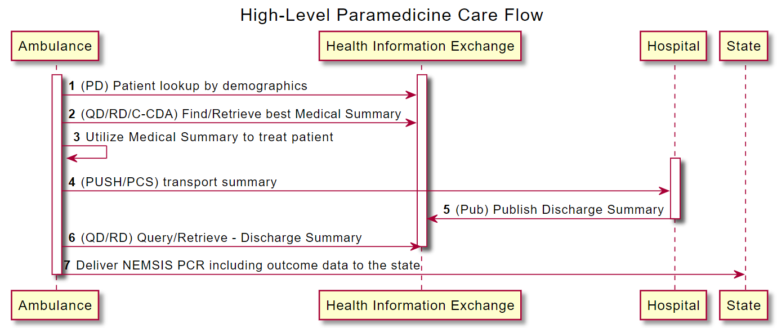
EMS-to-Hospital Information Flow

Slide 6
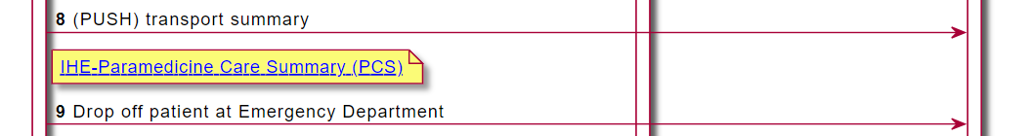
EMS-to-Hospital Information Flow

Slide 7
HL7 Clinical Document Architecture (CDA)
Level 1
Unstructured content
Level 2
Unstructured content within structured sections
Level 3
Structured content

Slide 8
Consolidated CDA (C-CDA) Document Types
Care Plan
Consultation Note
Continuity of Care Document
Diagnostic Imaging Report
Discharge Summary
History and Physical
Operative Note
Procedure Note
Progress Note
Referral Note
Transfer Summary
Unstructured Document
Notes:
https://en.wikipedia.org/wiki/Consolidated_Clinical_Document_Architecture

Slide 9
HL7 CDA R2: Emergency Medical Services Patient Care Report
Active
Release 3
May 2022
NEMSIS 3.4, 3.5
HL7 v3
HL7 CDA Level 3
ClinicalDocument
EMS Patient Care Report

Slide 10
IHE Paramedicine Care Summary (PCS)
Trial Implementation
Revision 1.1
September 2018
NEMSIS 3.4
HL7 v3, FHIR
Unpublished 2.0 revision underway (N 3.4+3.5)
HL7 CDA Level 2
IHE Medical Document
IHE Medical Summary
Constrains medications, allergies, problems to Level 3
Paramedicine Care Summary
Complete Report (CR)
Clinical Subset (CS)
Notes:
Need 3 vendors to pass Connectathon testing in order to move from Trial Implementation to Final Text.

Slide 11
Should We Use C-CDA Documents?
Care Plan
Consultation Note
Continuity of Care Document
Diagnostic Imaging Report
Discharge Summary
History and Physical
Operative Note
Procedure Note
Progress Note
Referral Note
Transfer Summary
Unstructured Document
Notes:
https://en.wikipedia.org/wiki/Consolidated_Clinical_Document_Architecture

Slide 12
SAFR: HL7 V2
Alert
File
Pre-Admit: ADT-A05
Vitals: ORU-R01
Narrative: MDM-T02
EKG: MDM-T02
MDM-T02
Notes:
ADT: Admit, Discharge, and Transfer
ORU: Observation Result
MDM: Medical Document Management

Slide 13
WISHIN: HL7 V2
Alert
File
ADT
MDM
Notes:
ADT: Admit, Discharge, and Transfer
MDM: Medical Document Management

Slide 14
What About Sending Small Bits of Information?
Hospital specialty team alert/activation
ECGs
A set of vitals
Narrative

Slide 15
What resources are needed to help software transform NEMSIS data into the desired format(s)?
Notes:
Solicit help from participants.

Slide 16

Did We Answer Today’s Questions?
HL7 CDA EMS Patient Care Report: Is this implementation guide ready to use, and can hospitals support it?
IHE Paramedicine Care Summary: Is this profile ready to use, can hospitals support it, and how does it relate to the HL7 CDA EMS PCR?
HL7 CDA Continuity of Care Document: Can and should this be supported?
HL7 CDA Unstructured Document: How much is this being used today?
What about sending bits of EMS information (not a full report)?
Hospital specialty team alert/activation
ECGs
A set of vitals
Narrative
What resources are needed to help software transform NEMSIS data into the desired format(s)?
Notes:
Give link to survey in chat:
https://forms.office.com/r/Z1ER9MqctE

Slide 17
Next Steps
Survey for today’s task force call
Task Force Email Group
groups.google.com/g/ems-task-force
Github Repository and Wiki
github.com/IHE/EMS
NEMSIS Annual Meeting: EMS Interoperability Workshop on August 22
ONC Annual Meeting: Interoperability Summit on the afternoon of December 15 (tentative)
Notes:
ONC annual meeting December 14-15 in DC. Interoperability summit tentatively planned for December 15, 12-3:30p ET.

